Slide 1
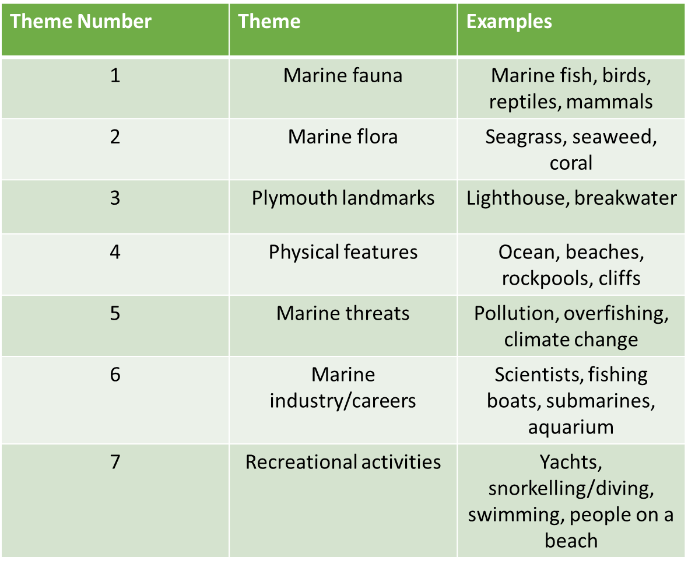
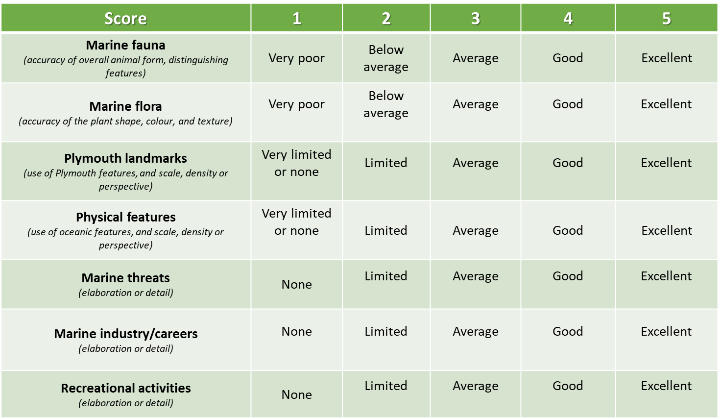
Breadth
Depth
*relativity to NMP
*
*

Slide 2
ID | Breadth Score (1-5) | Breadth Reasoning | Extent Score (n) | Extent Reasoning | Depth Score (1-5) | Depth Reasoning
1 | 1 | Theme 1: Marine fauna | Theme 1: 2 | Theme 1: Seabird & jellyfish | Theme 1: 2 | Theme 1: Simple outlines allows for identification of the animal (bird has wings and beak, jellyfish has a bell and tentacles) however they are very anatomically incorrect e.g. bird has three beaks, jellyfish has eyes. 2 species in drawing are non-marine
2 | 3 | Theme 1: Marine fauna Theme 2: Marine flora Theme 4: Physical feature | Theme 1: 1 Theme 2: 1 Theme 4: 1 | Theme 1: Turtle Theme 2: Seaweed Theme 4: Ocean | Theme 1: 3 Theme 2: 1 Theme 4: 1 | All features are correctly coloured. Theme 1: Turtle does not resemble leatherback due to colouration and presence of scutes on shell and therefore is not a native animal to NMP. Turtle is also missing back fins and is unproportionate to rest of drawing. Theme 4: Ocean done in little detail- no waves, evidence of water column, Theme 2: Seaweed done in little detail and on top of water
3 | 3 | Theme 1: Marine fauna Theme 2: Marine flora Theme 4: Physical feature | Theme 1: 2 Theme 2: 2 Theme 4: 1 | Theme 1: Shark & fish Theme 2: Seaweed/coral Theme 4: Ocean | Theme 1: 3 Theme 2: 2 Theme 4: 2 | Theme 1: Shark incorrectly coloured, shape indicates species of shark (hammerhead), although this is a non-native species. Fish is generic shape and does not include any defining features which could indicate whether it is a native species or not. Theme 2: Little detail. Differentiation in colour could show understanding of different seaweed species/show pink sea fans Theme 4: Use of colour all over (which covers all flora and fauna) shows an understanding of the ocean being a home to animals and plants Note: Doubt over whether a 4 year old actually drew this!
4 | 3 | Theme 1: Marine Fauna Theme 4: Physical features Theme 7: Recreational activities | Theme 1: 2 Theme 4: 1 Theme 7: 1 | Theme 1: Cuttlefish & crab Theme 4: Ocean Theme 7: Sailing boat | Theme 1: 4 Theme 4: 3 Theme 7: 4 | Theme 1: Animals are drawn anatomically correct (cuttlefish with 6 arms assuming tentacles are hidden, crab with 10 arms), are correctly positioned in the water column with remotely correct colouration (cuttlefish shouldn’t be red) Theme 4: Representation of waves and good positioning in relation of the rest of the things in the drawing (underneath the boat, surrounding the animals) Theme 7: Boat is very accurately drawn with bigger sail at the front and smaller at back and accurately shaped hull
5 | 1 | Theme 1: Marine Fauna | Theme 1: 3 | Theme 1: Jellyfish, starfish & octopus | Theme 1: 2 | Theme 1: Animals drawn with mixed accuracy (starfish has 5 arms, jellyfish has bell and many tentacles, octopus has mantle and arms) and inaccuracy (starfish eyes and mouth incorrect places, same for octopus). Animals are not drawn in relative size to one another. Additional feature is assumed to be a mermaid due to curvature of the bottom of the figure instead of a person in the NMP.
6 | 3 | Theme 1: marine fauna Theme 4: Physical features Theme 6: Marine industry/careers | Theme 1: 1 Theme 4: 1 Theme 6: 1 | Theme 1: Whale Theme 4: Ocean Theme 6: Fishing vessel | Theme 1: 3 Theme 4: 2 Theme 6: 3 | Theme 1: Whale is drawn with good accuracy and proportion, with a long mouth and small eyes towards the top of the head. Also includes the detail of whale sounds, however is missing its fins Theme 4: Ocean includes waves and is positioning is accurate (under boat, home to the whale), no detail on depth or indication of an understanding of the water column
7 | 1 | Theme 1: marine fauna | Theme 1: 2 | Theme 1: Orca & fish | Theme 1: 4 | Theme 1: Great detail- inclusion of orca markings and the shape make it clear this is the animal being drawn. Details of scales, dorsal, pectoral and chordal fins on fish. Colouration of orca incorrect but a relatively similar shade has been chosen (would have lost more points for choosing pink or red).Orcas can be found in NMP, however, drawn fish is a non native species of the NMP. Note: Doubt over whether a 4 year old actually drew this!

Slide 3
ID | Breadth Score (1-5) | Breadth Reasoning | Extent Score (n) | Extent Reasoning | Depth Score (1-5) | Depth Reasoning
8 | 1 | Theme 1: Marine fauna | Theme 1: 1 | Theme 1: Anglerfish | Theme 1: 2 | Theme 1: Presence of chordal, dorsal and pectoral fin indicates a marine creature has been drawn, however large teeth and possible lure indicates an anglerfish, which is not an NMP animal
9 | 3 | Theme 1: Marine fauna Theme 6: Marine industry/careers Theme 7: Recreational activities | Theme 1: 3 Theme 6: 1 Theme 7: 4 | Theme 1: Shark, dolphin, whale Theme 6: Aquarium Theme 7: Scuba diving, snorkelling, paddleboarding, swimming | Theme 1: 2 Theme 6: 1 Theme 7: 1 | Theme 1: Poor accuracy of shape outline to allow identification of animal, some features such as fins and blowholes present on some but missing on others Theme 6: Label for aquarium- no detail Theme 7: Labels for activities- no detail Note: The child appears to not have drawn the NMP at all, but rather a marine themed amusement/water park
10 | 3 | Theme 1: Marine fauna Theme 4: Physical features Theme 6: Marine industry/careers | Theme 1: 4 Theme 4: 2 Theme 6: 1 | Theme 1: Lobster, turtle, shark, orange fish Theme 4: Waves, bubbles Theme 6: Submarine | Theme 1: 3 Theme 4: 1 Theme 6: 2 | Theme 1: Lobster is missing legs, shark and fish are missing pectoral fins and colouration for all animals is incorrect (similar colours have been chosen for all however). Despite missing parts, shape outlines for animals are relatively accurate and extra details have been included e.g. scutes on turtle shell, gills on shark Theme 4: Very simple waves and bubbles- no indication of where bubbles are from Theme 6: Accurate colouration and outline to deep sea submarine, however placement does not demonstrate understanding of deep sea exploration (not at very bottom of drawing, amongst non deep sea animals)

Slide 4
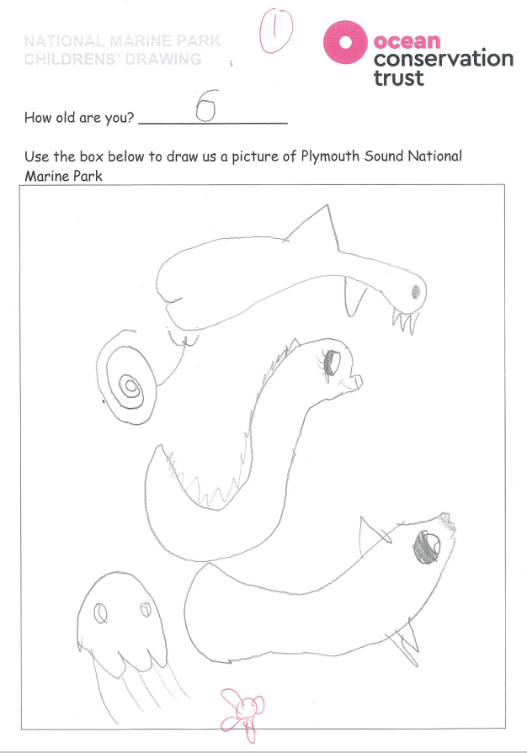

Slide 5
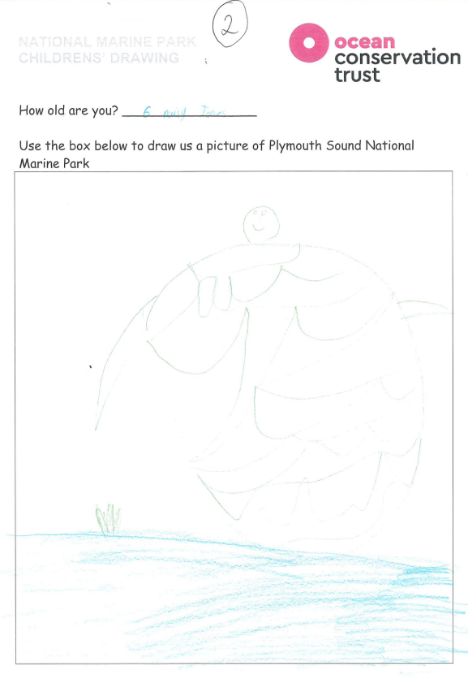

Slide 6
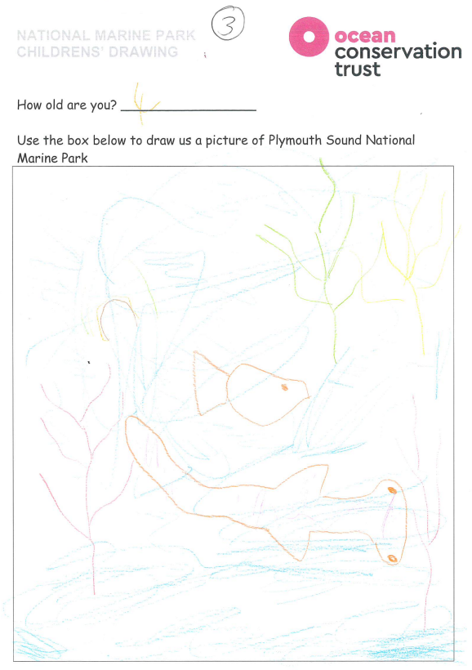

Slide 7
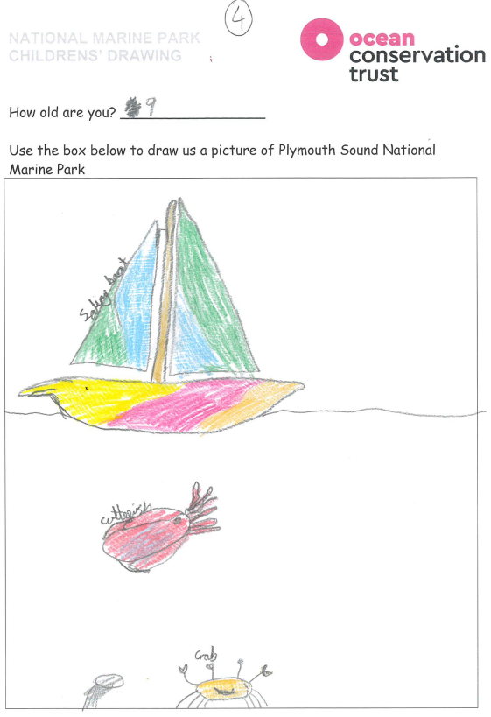

Slide 8
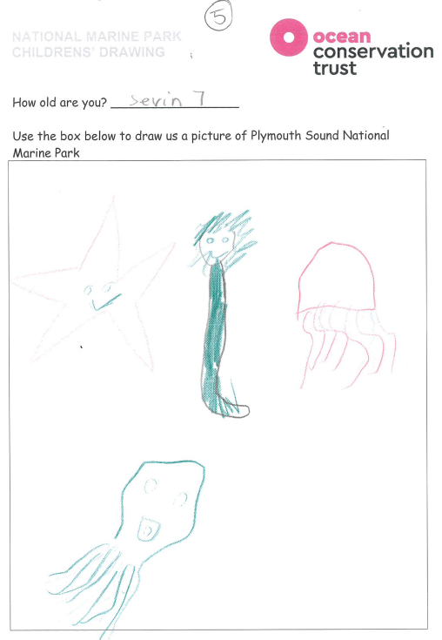

Slide 9
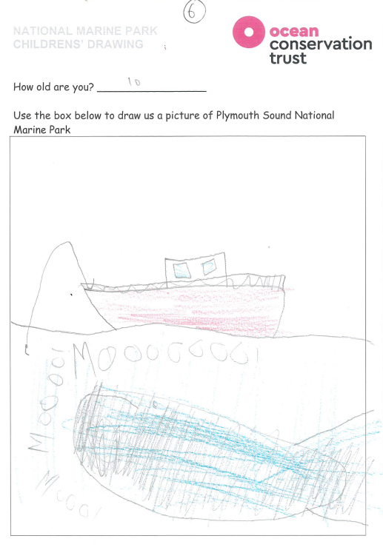

Slide 10
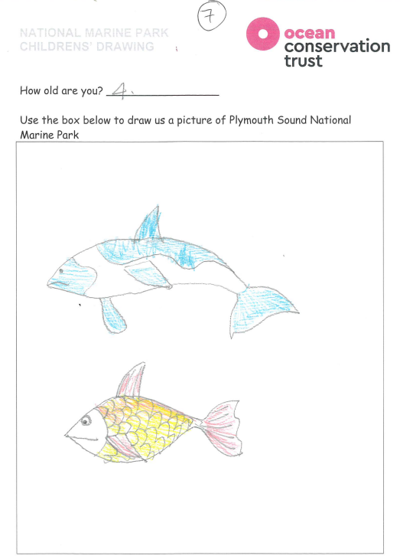

Slide 11
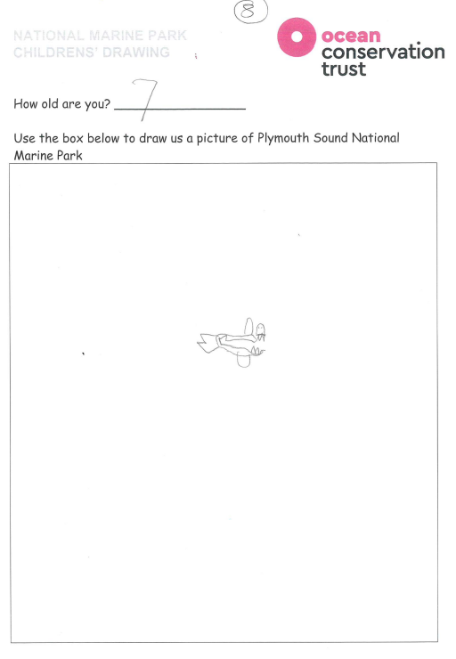

Slide 12
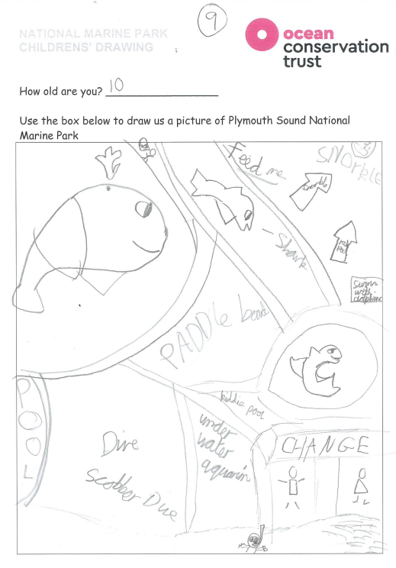

Slide 13
